Slide 1
Mirrored pan-tilt camera tracking
Ramon Ortega
Grant Latham

Slide 2
Agenda
The whys and the wherefores
The Jungle
The justification of the means

Slide 3
Motivation
Existing camera gimbal systems are large, heavy, and relatively slow.
Rotating small mirrors is much easier than rotating the entire camera
If the system is sufficiently small and lightweight, it can be packaged in a handheld system

Slide 4
Methods
System components
Two servo motors to rotate the mirrors
IMU to measure motion
Arduino Uno to interface IMU with servos
Two types of operation addressed
Stationary camera, moving target
Characterized step response and maximum rotation speed
Stationary target, moving camera
Full, if imperfect implementation

Slide 5
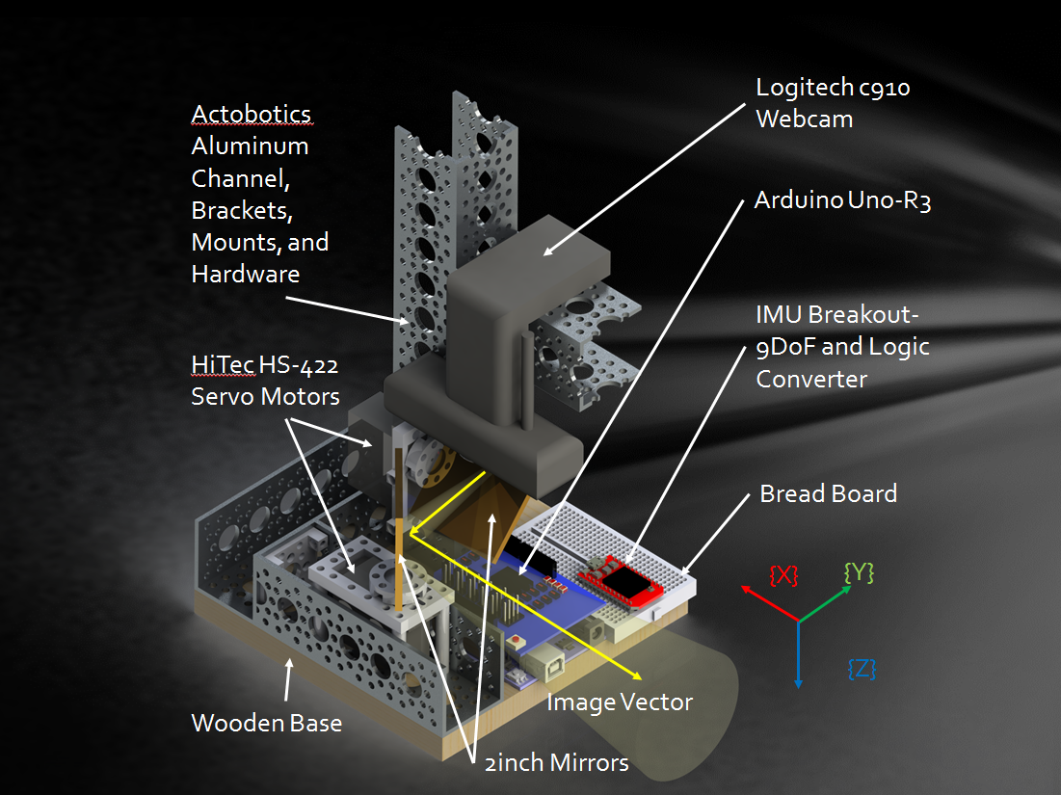
Machine Components

Slide 6
Commanding Servos for Image Satiation of Stationary Target
Upper servo angle controlled by pitch from accelerometer
Upper servo angle controlled by yaw from gyroscope
Θ
{X}world
{X}world
{Y}world
{Y}world
{ry}machine
{ay}machine
{az}machine
{ax}machine
R
{rx}machine
{rz}machine
R onZ
g
{Z}world
{Z}world

Slide 7

Results
Step response data
$$G=\frac{0.972}{0.0359s+1}$$

Slide 8

Results
Camera motion compensation was qualitatively successful with rotations of $±30°$. Response time was slower than desired, but this is likely due to low quality components.

Slide 9
The Prestige

